Slide 1
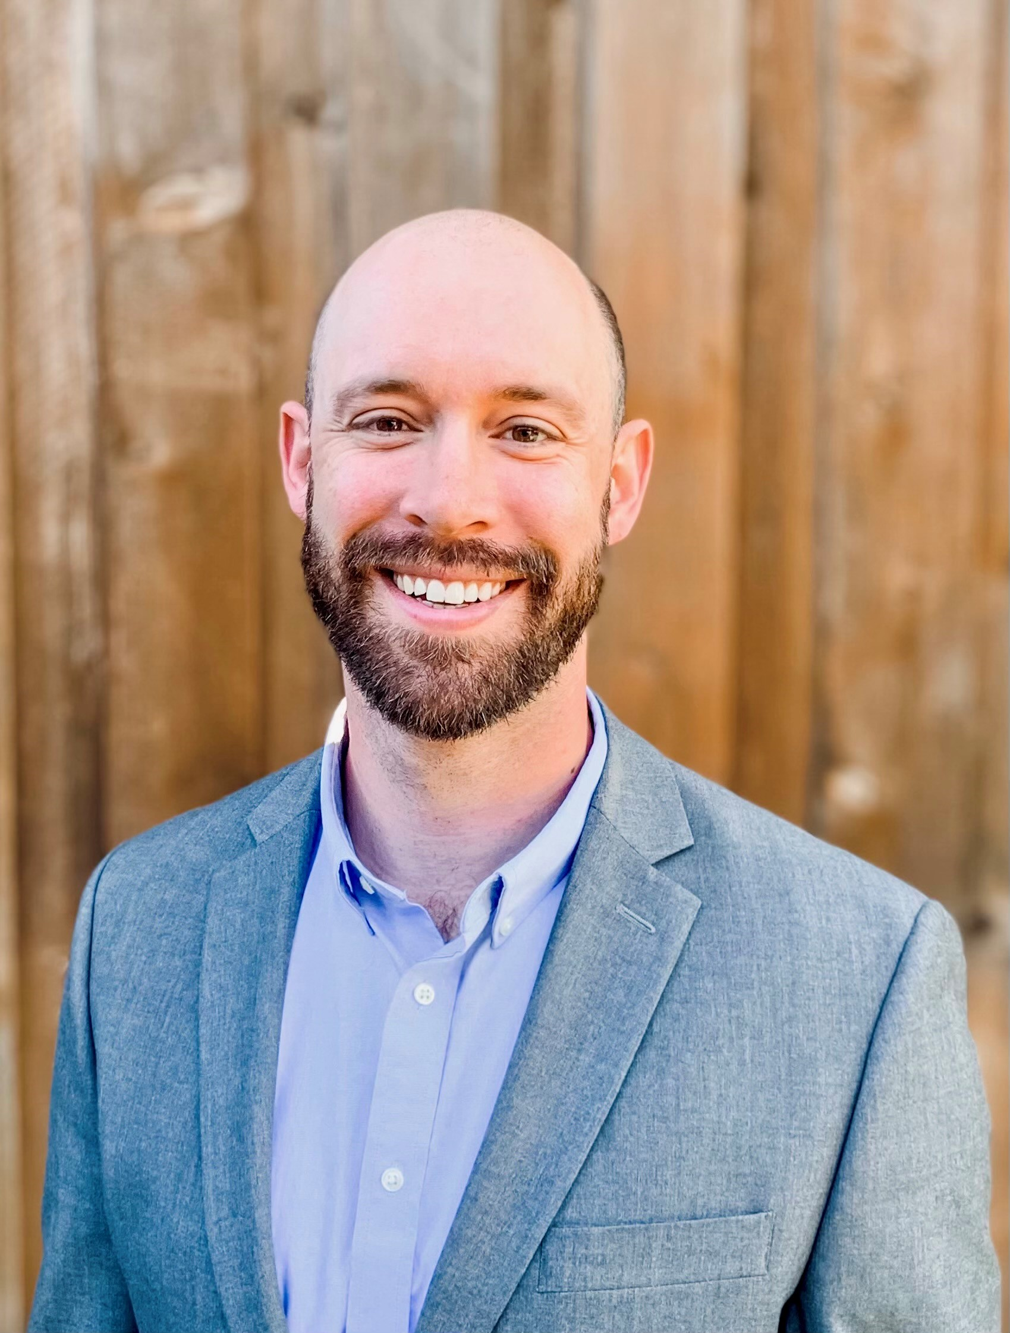
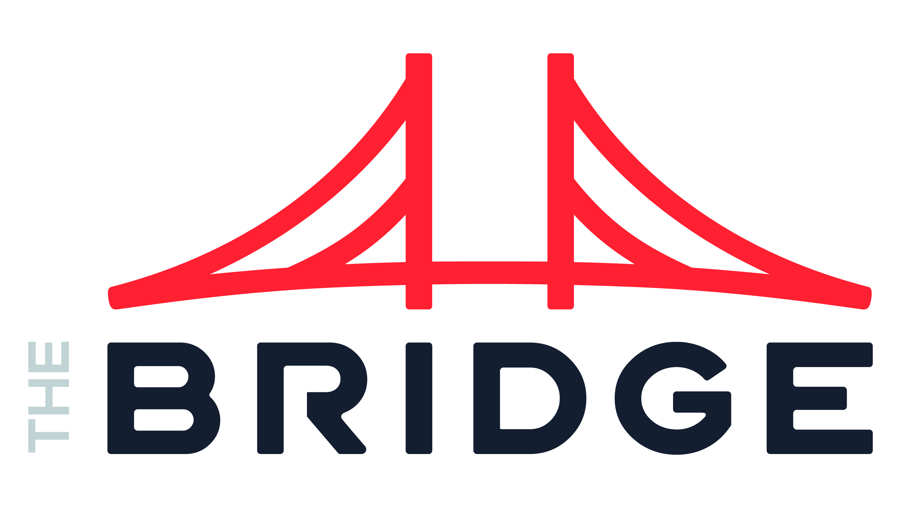
Eric Hilton Data & AI
INDUSTRIES
Industry Experience
Consumer and Industrial Products | Healthcare | High-Tech & Software | Private Equity | Real Estate | Retail | Financial Services | Restaurant
EXPERIENCE
ML-Driven Subrogation Case Closure | Healthcare
Problem: Client had a large overqualified workforce focused on combing through a backlog of unresolved subrogation claims resulting delayed receivables tied up in high-volume low value work
Value: Automated subrogation case closure of low value cases. In doing so, Client could focus on higher dollar and more complex cases
Tools: R, Python, Alteryx, Informatica
Role: Functioned as a team lead facilitating sessions to identify and validate use cases, gather project success requirements, feature engineering, data engineering and project progress reporting and accountability
ML-Driven Food Forecasting| Restaurant
Problem: Client’s core product requires long prep times. During peak hours, customers would often experience long waits. To combat this, the kitchen staff overprepared, resulting in increased waste and cost
Value: A scalable ML forecasting model was put in place, factoring in historic and current ordering to predict volume allowing the kitchen staff to prepare food just-in-time. This resulted in shorter wait times for customer, less food waste, and lower costs
Tools: R, SQL Server, Talend
Role: Functioned as data lead and architect facilitating requirements gathering sessions, proposing and building data flow, architectures, and ML forecasting
BACKGROUND
Functional Skills
Data Leadership | Organizational Design | Generative AI Strategy | ML | MLOps | Data Science | Data Architecture | Data Engineering | Data Analysis and Visualization
Qualifications:
Consulting leader focused Data & AI strategy and implementation. Eric’s strategy experience involves advising over 200 companies up and down the market with unique ownership structures including private equity owned, owner operators, and publicly held. Eric’s implementation experience is similarly vast delivering quantifiable value in the form of enterprise data capabilities aligned with business outcomes
BIO & CONTACT INFO
Email
Eric.Hilton@thebridge.com
Mobile
(972) 757-3348
Location
DFW, Texas
Eric has over 15 years consulting in Data and AI serving companies in the fortune 10 and startups alike. He’s passionate about data, agile delivery, efficiency, and delivering measurable value. In his free time, he enjoys spending time with his family, serving his community, coaching youth sports, and riding his Peloton

